Slide 1

Brighton City Centre
Business Improvement District (BID)
B&H Connected
3rd July 2018

Slide 2
Brilliant Brighton :
Incorp. since 2006
Now in its third iteration
ERS Ballot in 2016
74% in favour y vote
69% in favour by RV
10% On 2011 Ballot
Four main projects

Slide 3
Projects
Christmas Lights
City Dressing
PR / Marketing
City Centre Ambassadors

Slide 4
City Centre Ambassadors
Budget: £160,000
Cost: £146,389
Mobile Support Unit
Range of additional services

Slide 5
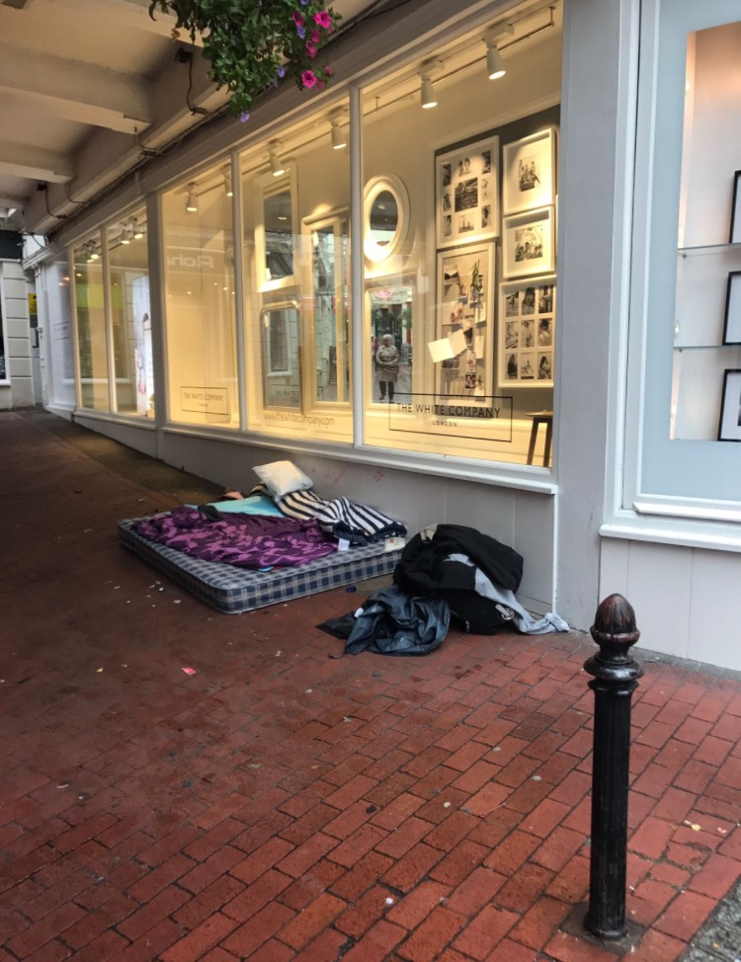
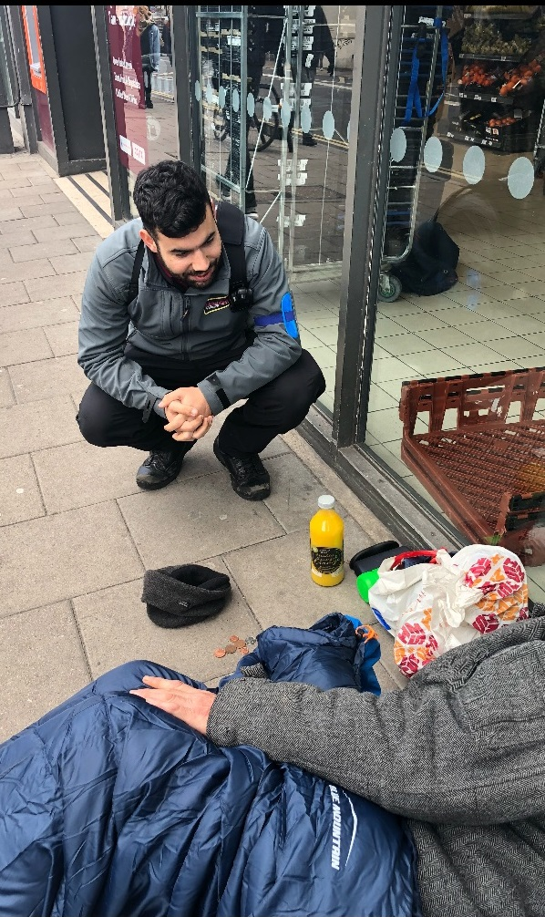
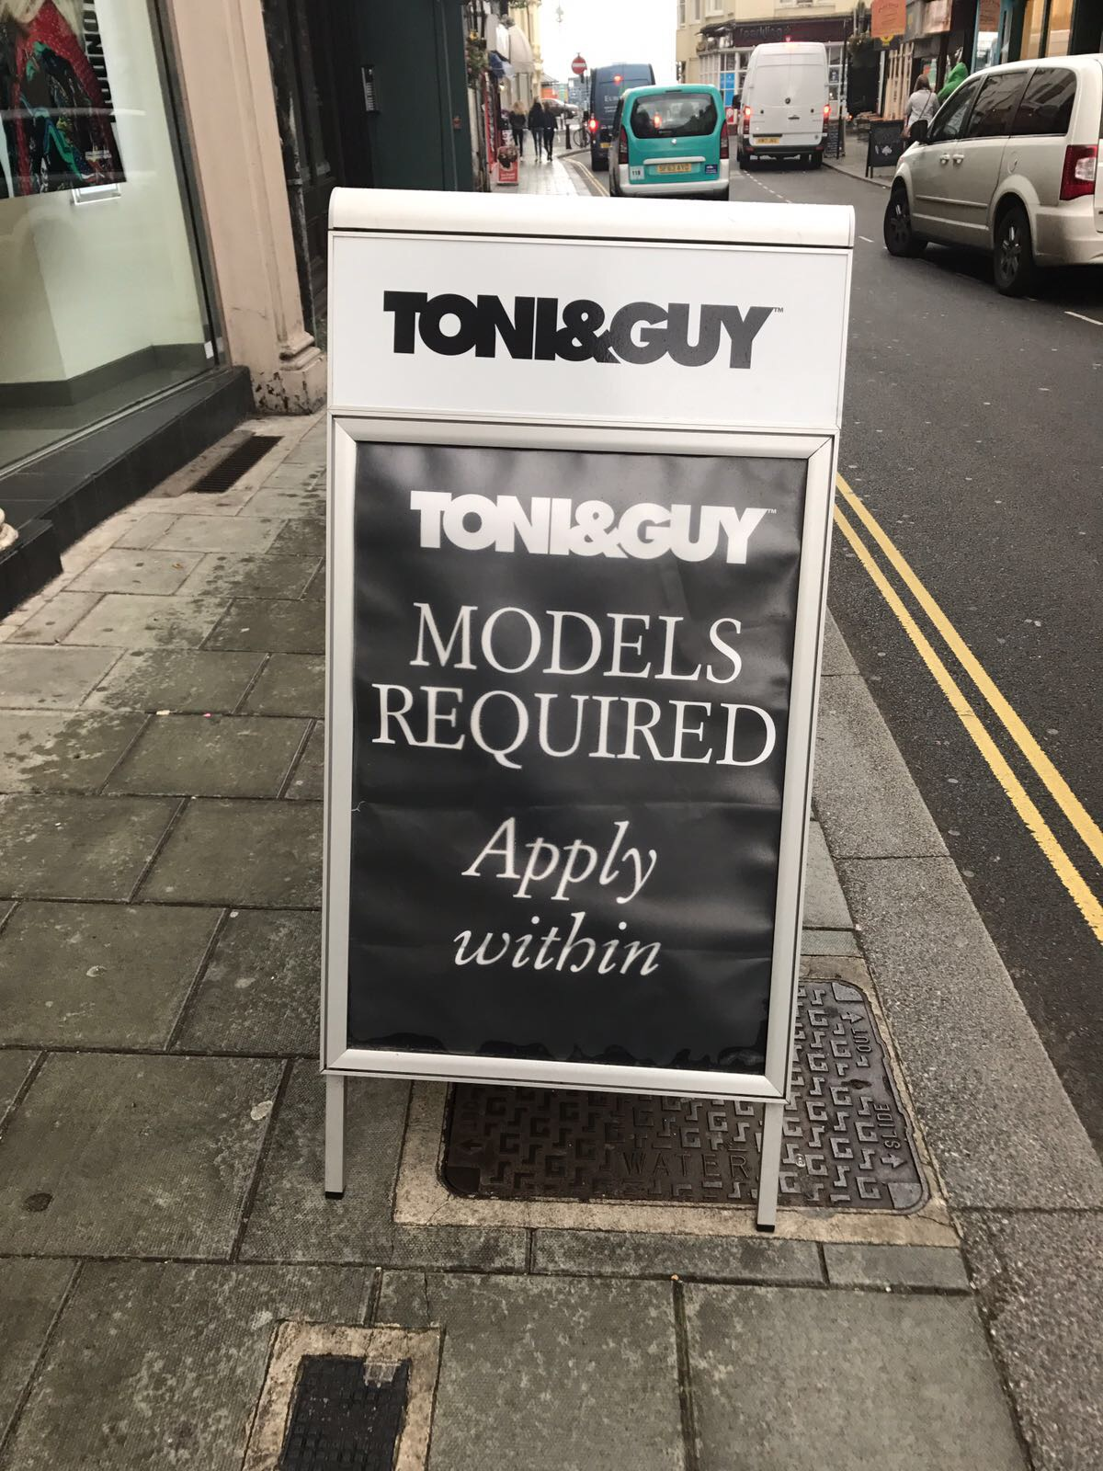
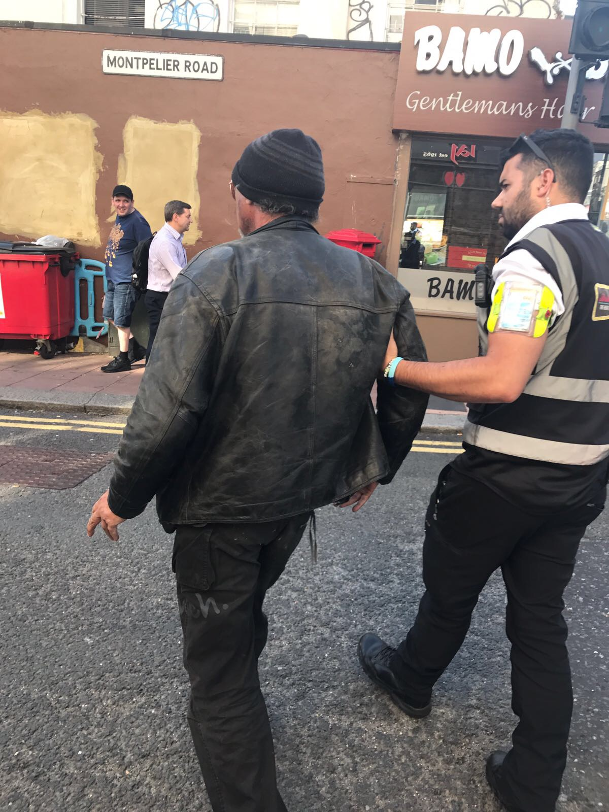
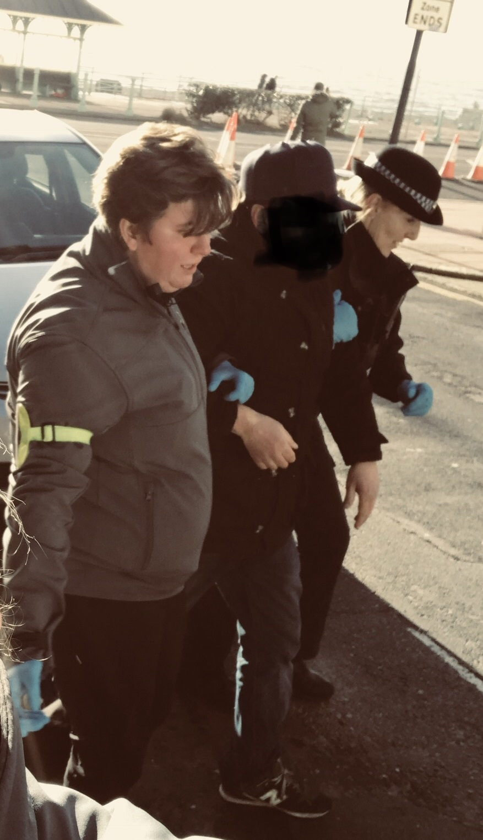
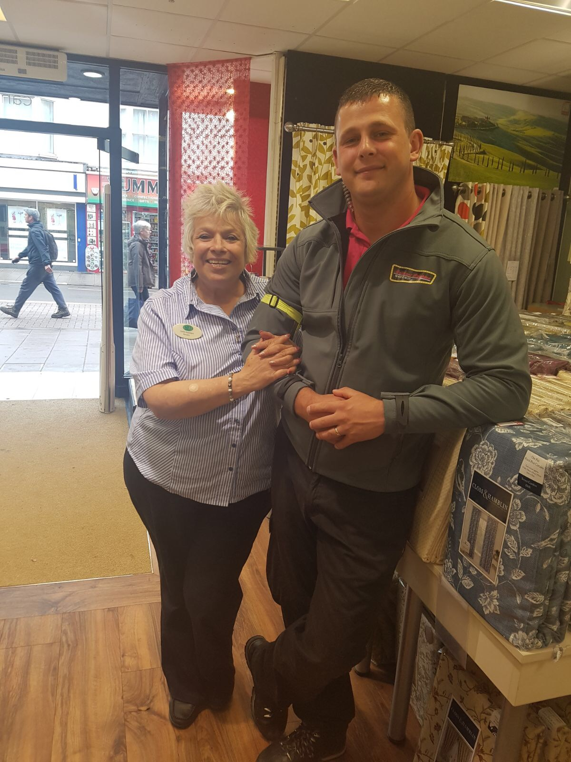
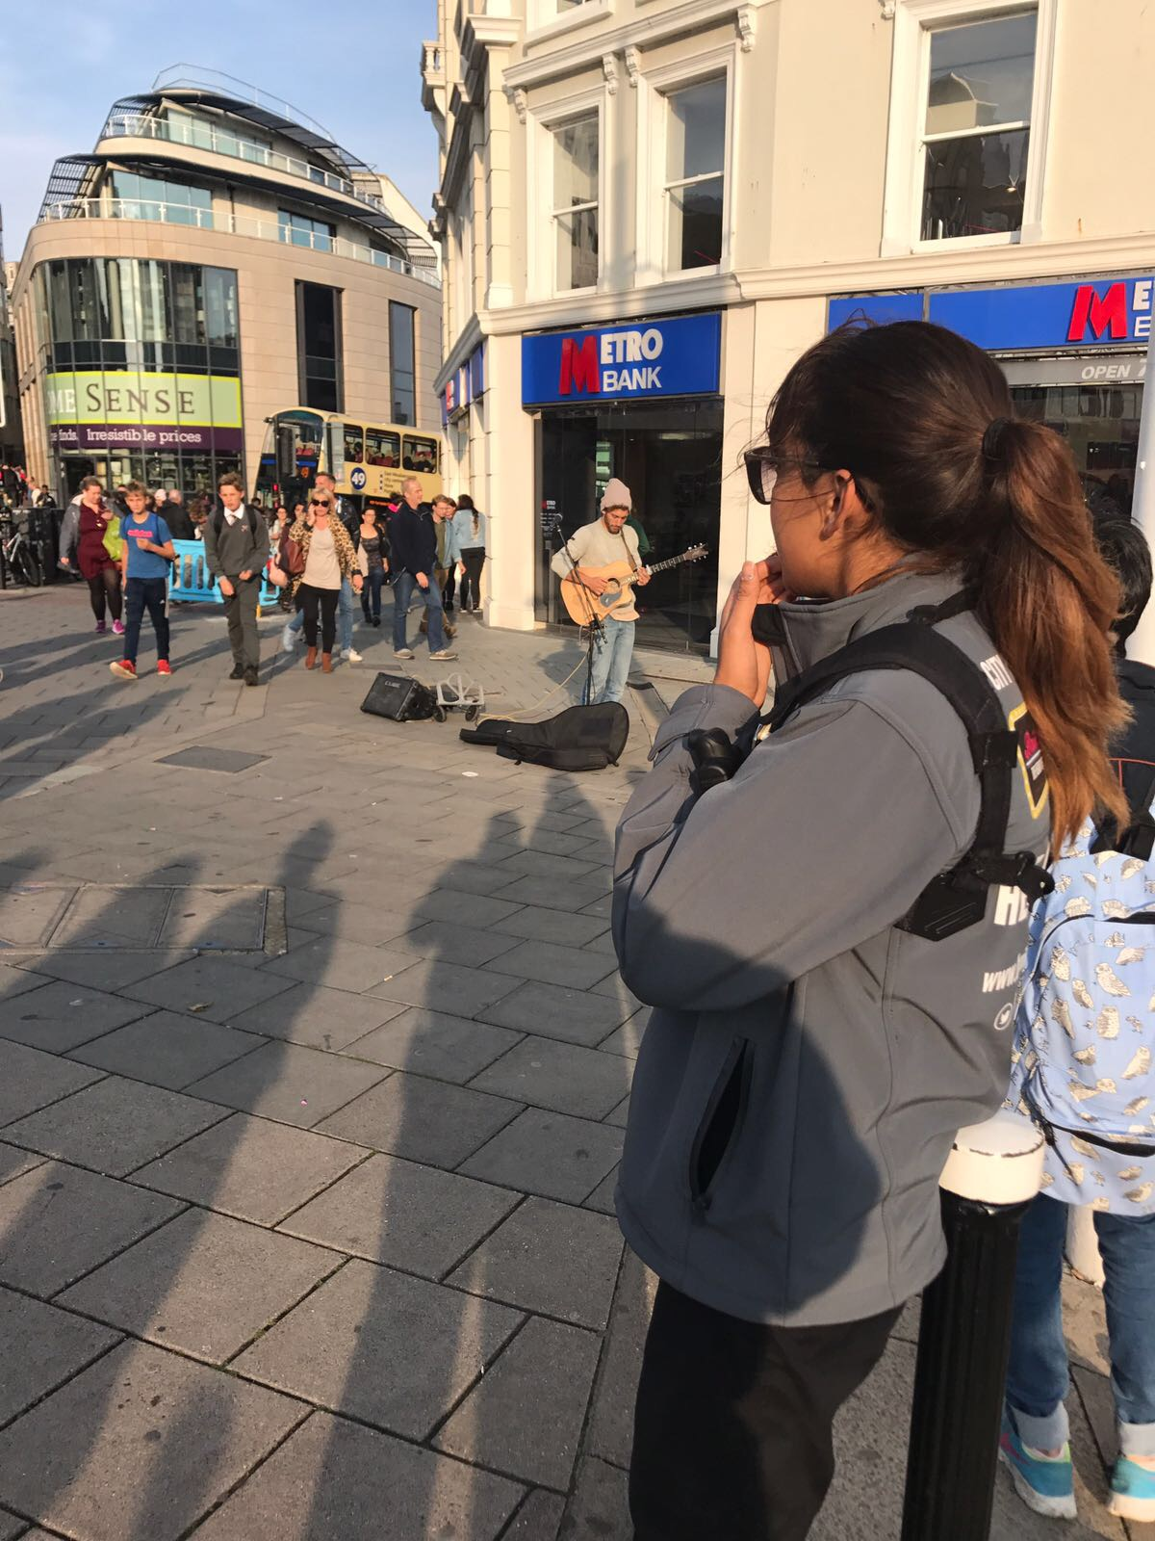
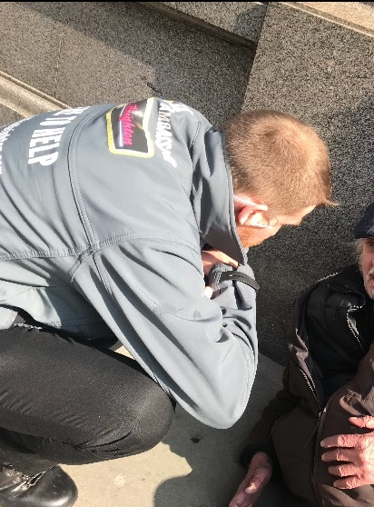
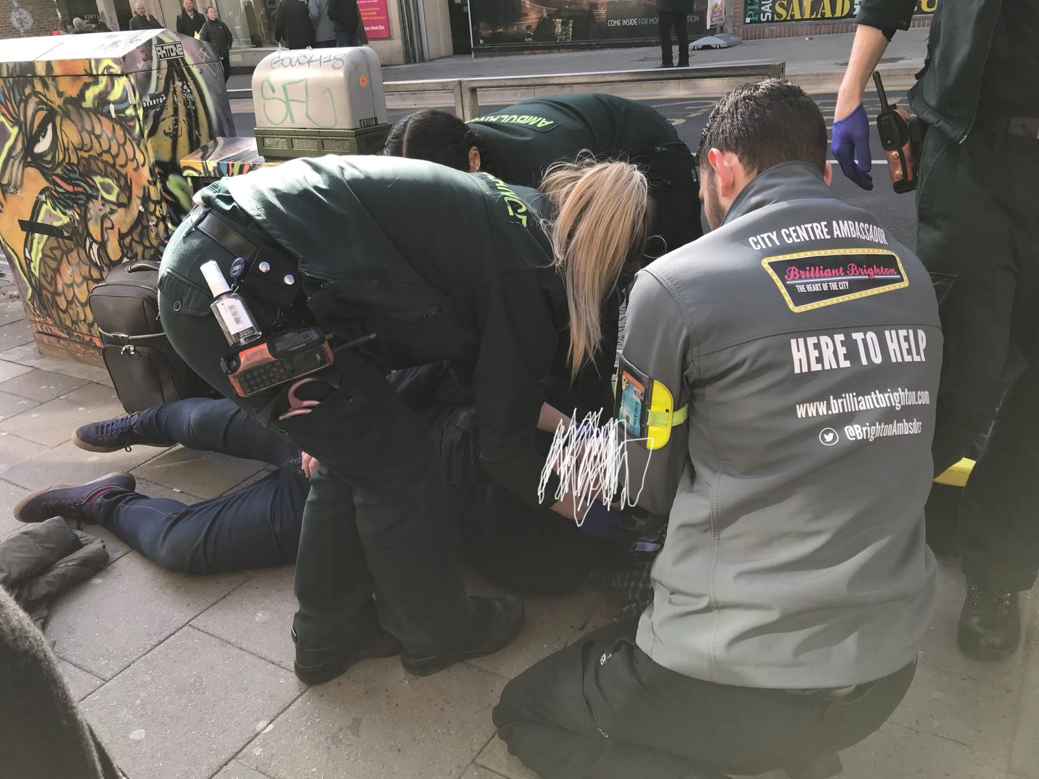
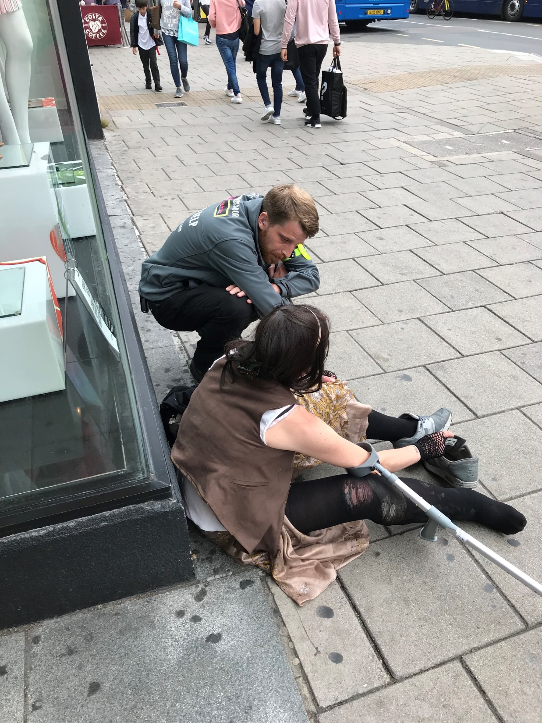
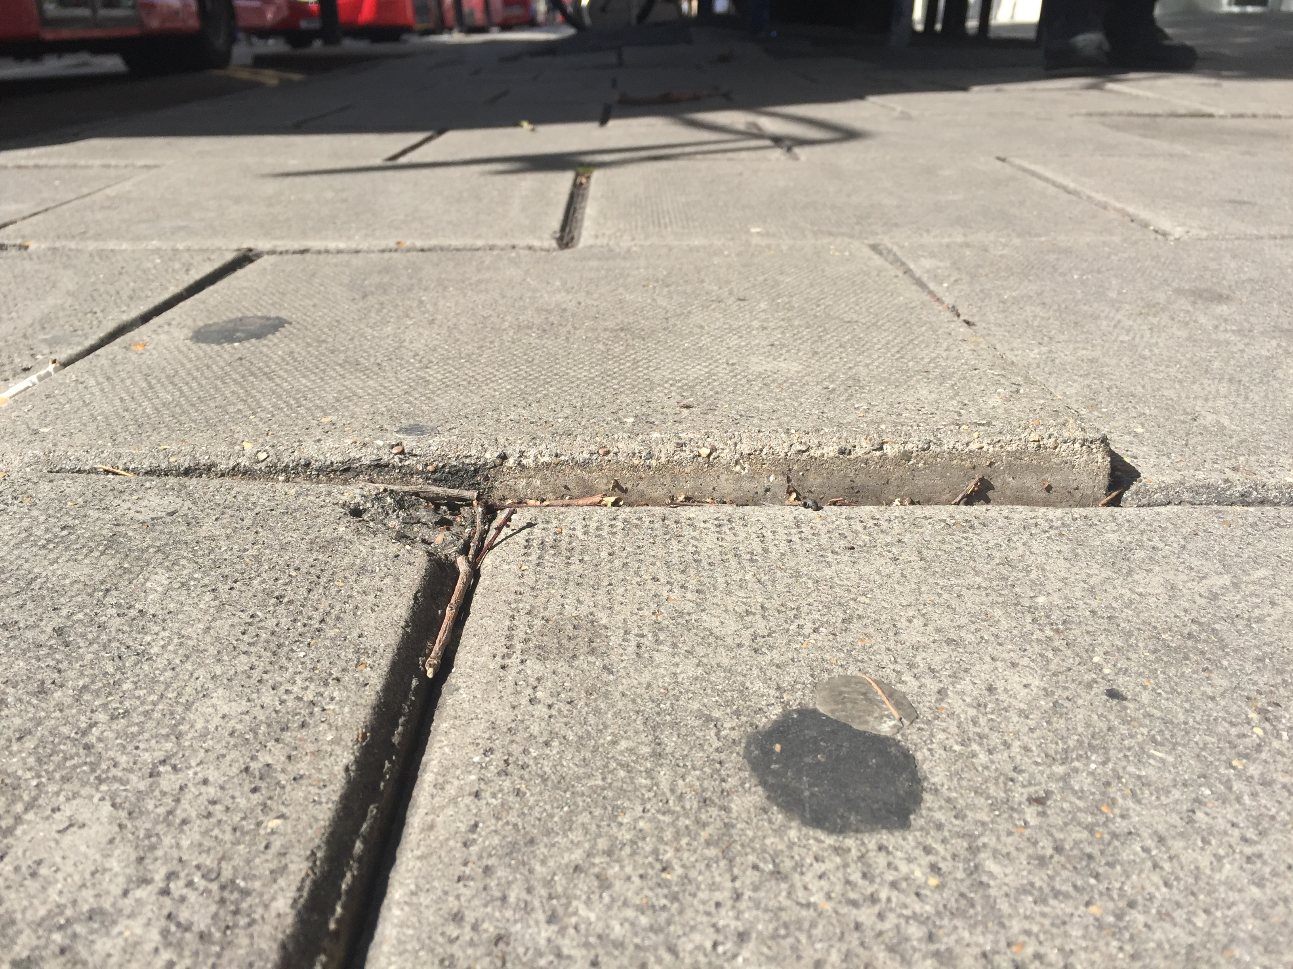
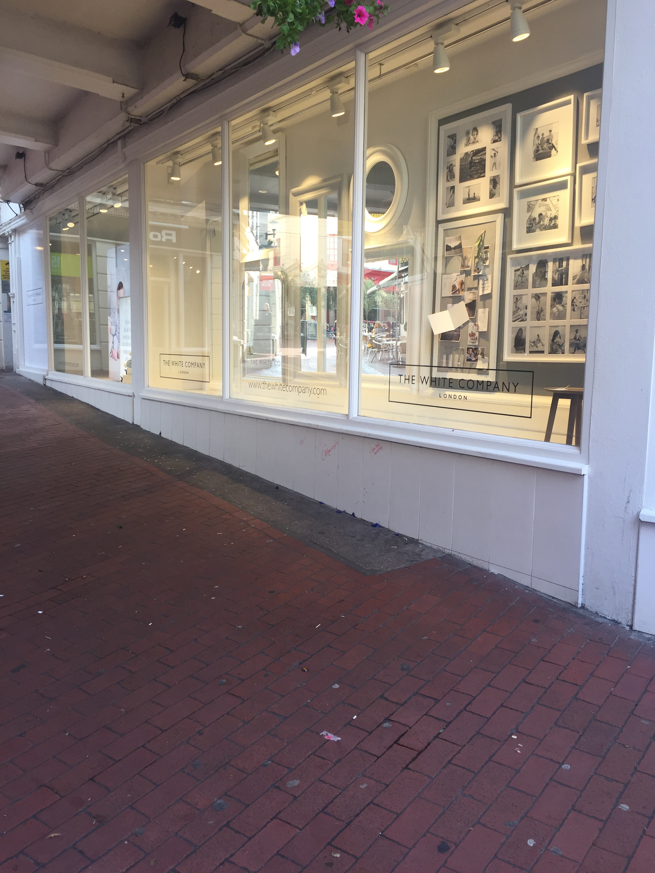
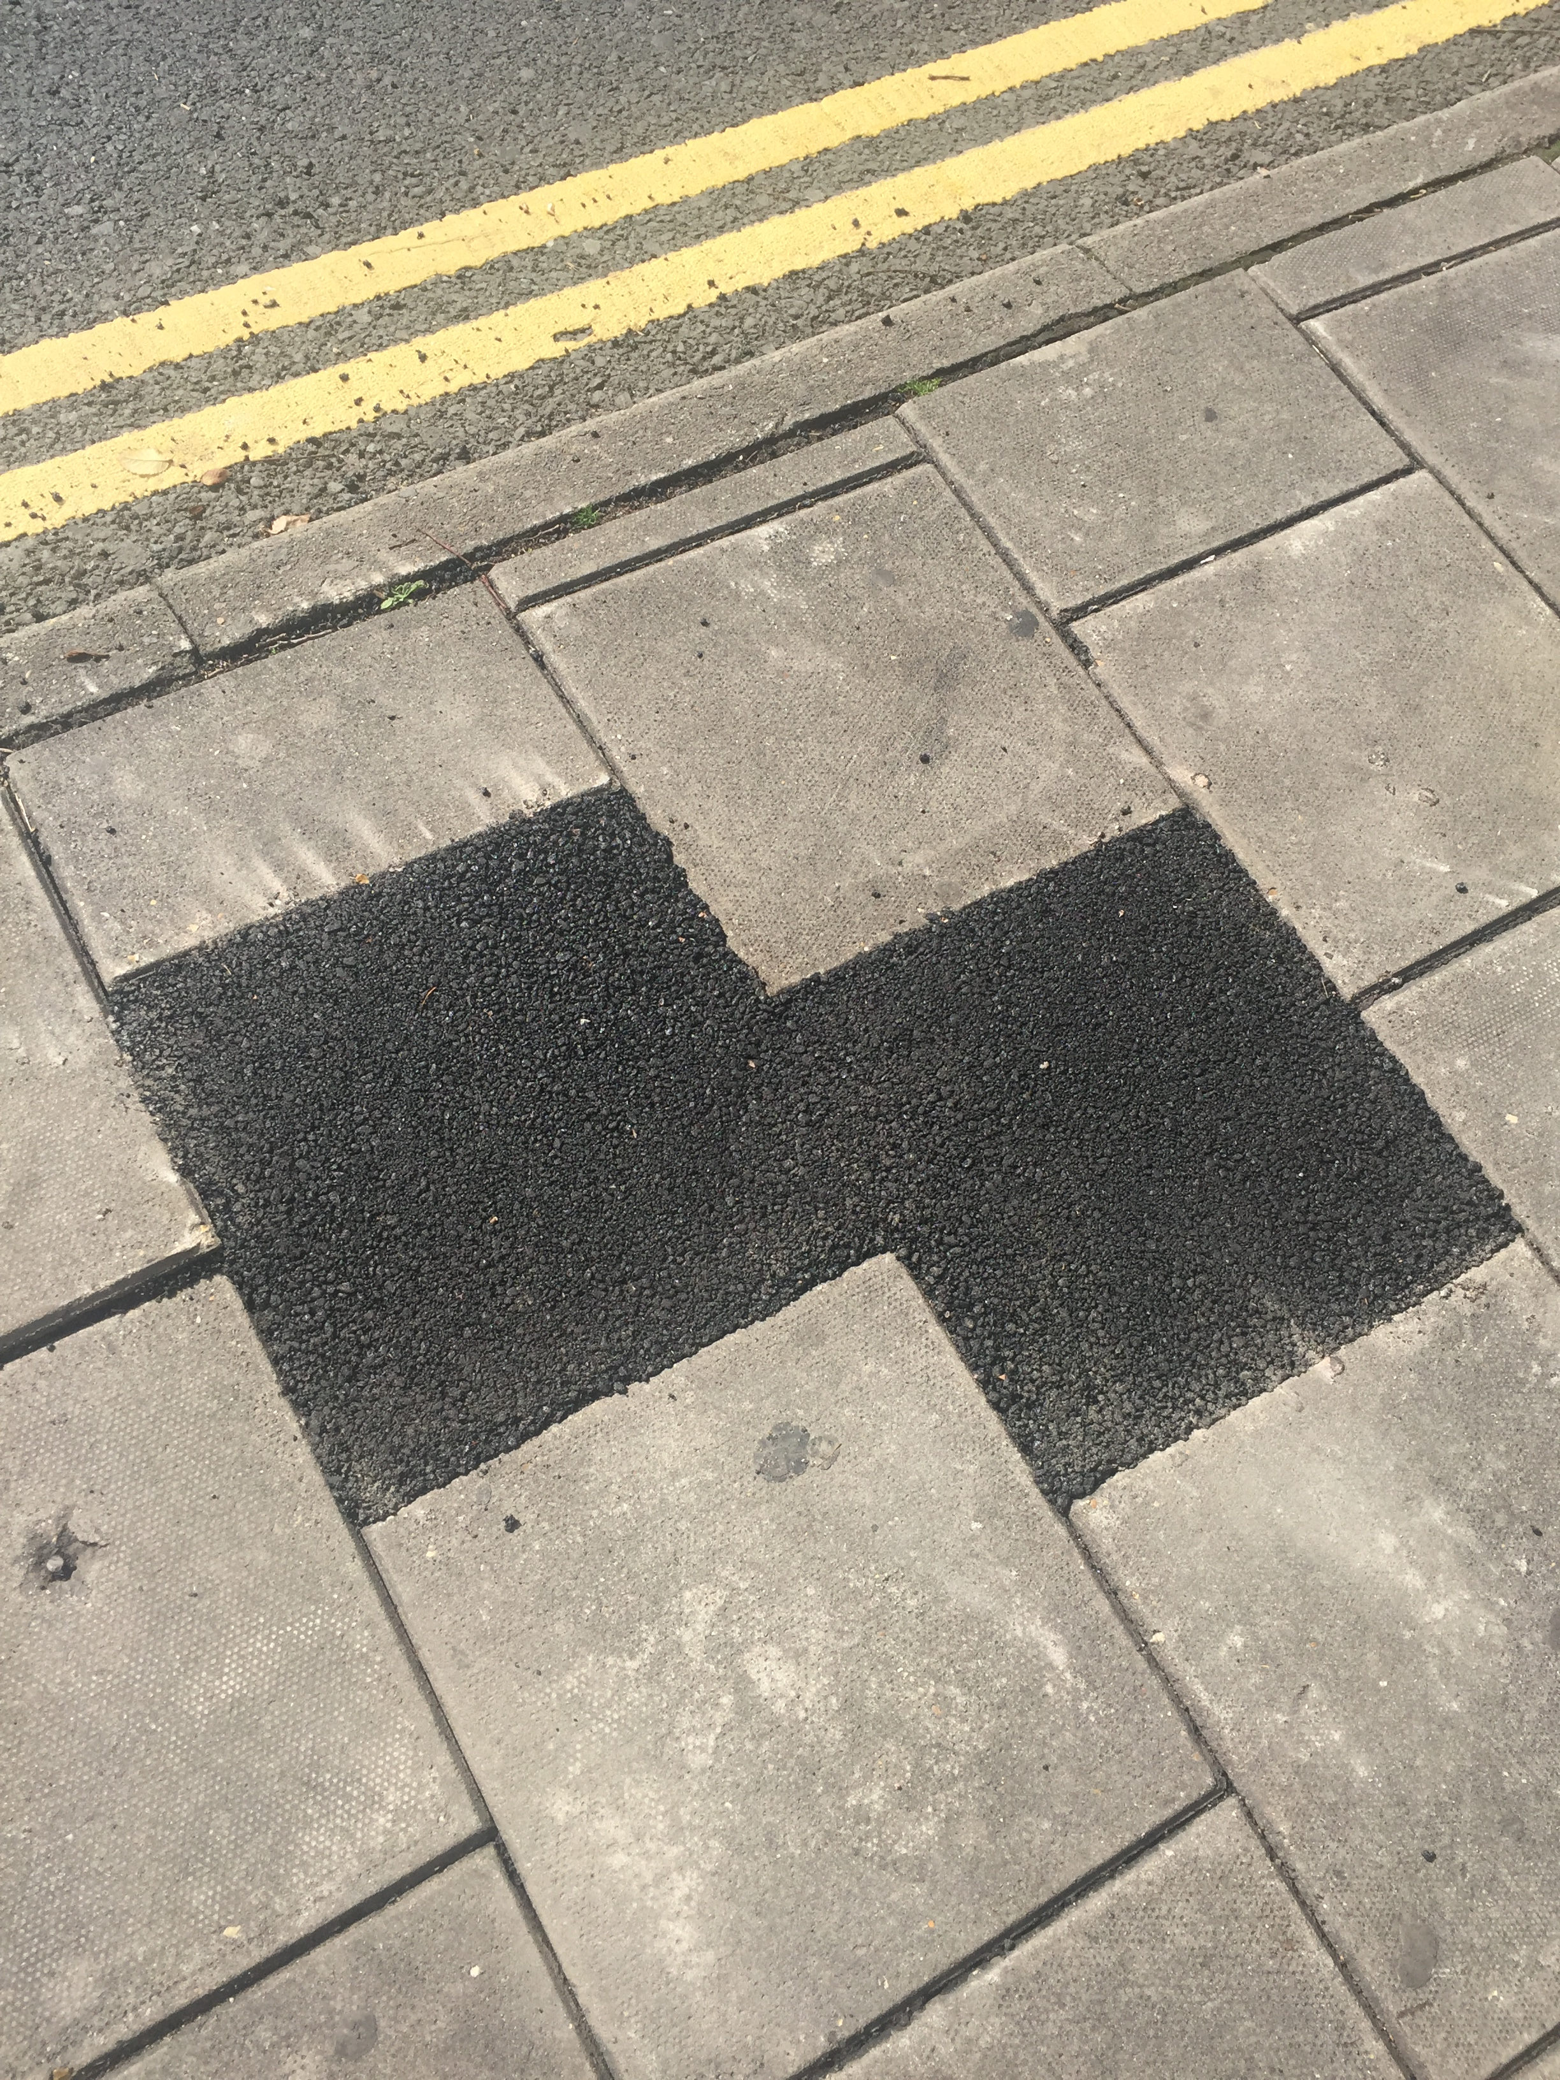

Slide 6
City Centre Ambassadors
241 reports of begging since start of Jan – real number much higher
50% of our overall time is spent dealing with the Street Community
shop theft
Begging
drunk and disorderly behaviour (being abusive to businesses and members of the public passing)
medical issues when they are incapacitated due to drink and drugs.

Slide 7
Partnership Working
Council
Sussex Police
BCRP
Signposting to local agencies
(e.g Equinox / YOS / St Mungo’s)
Still the need for more collaboration

Slide 8
Gavin Stewart
BID CEO gavin.stewart@brightonbid.com
01273 735442

